Slide 1
Number Theory
- Srivaths P

Slide 2
Goal:
To learn:
Basic Primality Testing
Sieve of Eratosthenes
Prime Factorization
Binary Exponentiation
Basic Modular Arithmetic

Slide 3
Primality Testing
A primality test is an algorithm for determining whether a number is prime or composite.
There are many algorithms for primality testing such as:
Brute-Force
Square Root method
U(precomputation)
Heuristic/Psing Sieve robabilistic Methods

Slide 4
Primality Testing – Code
Brute-Force:
Sqrt method:
bool is_prime(int n) { for (int i = 2; i < n; i++) if (n % i == 0) return false; return n > 1; }
bool is_prime(int n) { for (int i = 2; i*i <= n; i++) if (n % i == 0) return false; return n > 1; }

Slide 5
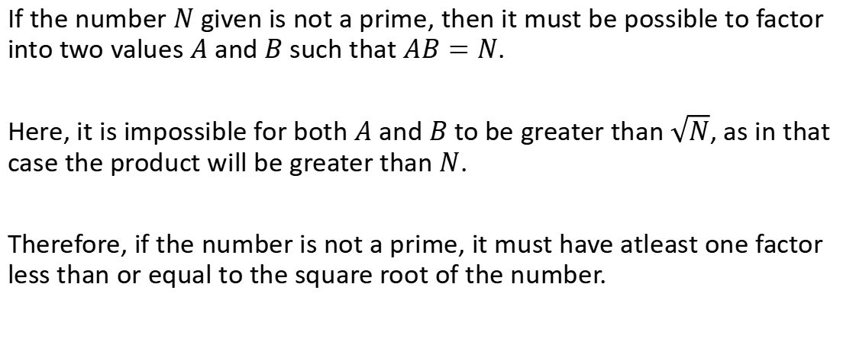
Square Root Method Proof
If the number $N$ given is not a prime, then it must be possible to factor into two values $A$ and $B$ such that $AB=N$.
Here, it is impossible for both $A$ and $B$ to be greater than $\sqrt{N}$, as in that case the product will be greater than $N$.
Therefore, if the number is not a prime, it must have atleast one factor less than or equal to the square root of the number.

Slide 6
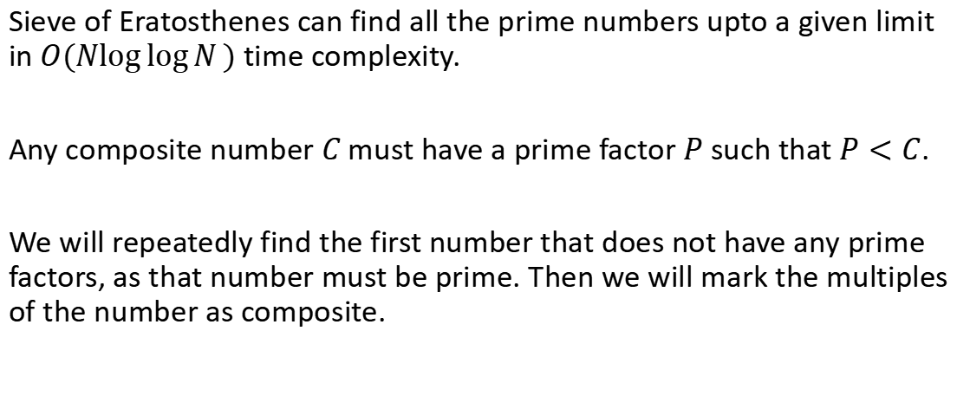
Sieve of Eratosthenes
Sieve of Eratosthenes can find all the prime numbers upto a given limit in $O(N\log{\log{N}})$ time complexity.
Any composite number $C$ must have a prime factor $P$ such that $P<C$.
We will repeatedly find the first number that does not have any prime factors, as that number must be prime. Then we will mark the multiples of the number as composite.

Slide 7
Sieve of Eratosthenes – Code
void sieve(int n) { bool primes[n+1]; fill(primes, primes+n+1, true); primes[0] = primes[1] = false; for (int i = 2; i*i <= n; i++) { if (primes[i]) for (int j = i*i; j <= n; j += i) primes[j] = false; } }

Slide 8
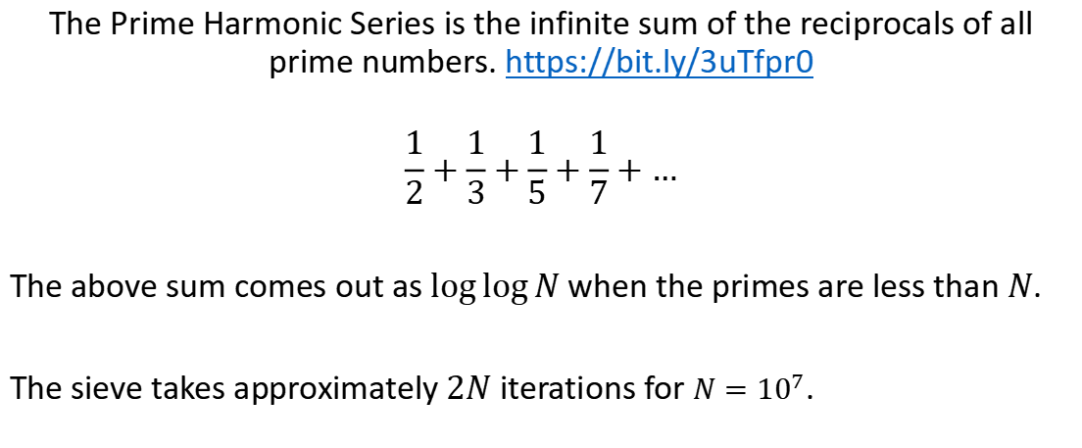
Sieve of Eratosthenes – Time Complexity
The Prime Harmonic Series is the infinite sum of the reciprocals of all prime numbers. https://bit.ly/3uTfpr0
$$\frac{1}{2}+\frac{1}{3}+\frac{1}{5}+\frac{1}{7}+…$$
The above sum comes out as $\log{\log{N}}$ when the primes are less than $N$.
The sieve takes approximately $2N$ iterations for $N={10}^{7}$.

Slide 9
Prime Factorization
Prime Factorization is finding all the prime factors of a given number.
There are multiple ways to factor primes, such as:
Trial Division
Wheel Factorization
Sieve method (precomputation)

Slide 10
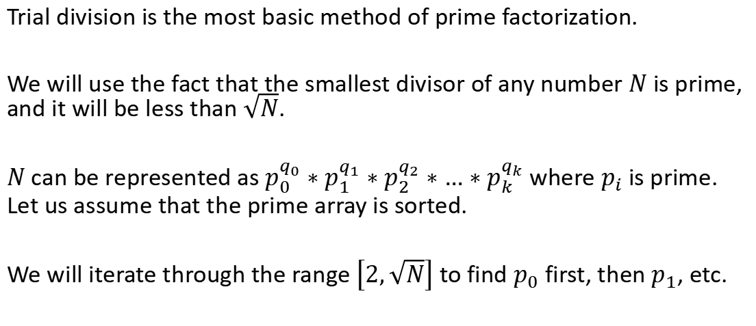
Prime Factorization – Trial Division
Trial division is the most basic method of prime factorization.
We will use the fact that the smallest divisor of any number $N$ is prime, and it will be less than $\sqrt{N}$.
$N$ can be represented as $p_{0}^{q_{0}}∗p_{1}^{q_{1}}∗p_{2}^{q_{2}}∗…∗p_{k}^{q_{k}}$ where $p_{i}$ is prime. Let us assume that the prime array is sorted.
We will iterate through the range $\left[2,\sqrt{N}\right]$ to find $p_{0}$ first, then $p_{1}$, etc.

Slide 11
Prime Factorization – Trial Division Code
vector<int> factor(int n) { vector<int> facts; for (long long d = 2; d * d <= n; d++) { while (n % d == 0) { facts.push_back(d); n /= d; } } if (n > 1) facts.push_back(n); return facts; }

Slide 12
Modular Arithmetic
Modular Arithmetic is arithmetic operations involving taking the modulo with some modulus. It is usually given in problem statements so that the solution doesn’t overflow in case the answer is huge.
A few operations involving modulo are:
Addition
Subtraction
Mutliplication
Division

Slide 13
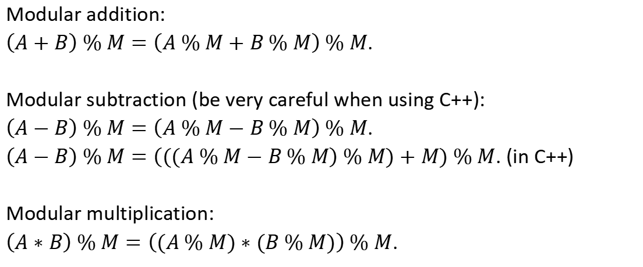
Modular Arithmetic
Modular addition:
$\left(A+B\right) \% M=\left(A \% M+B \% M\right) \% M$.
Modular subtraction (be very careful when using C++):
$\left(A−B\right) \% M=\left(A \% M−B \% M\right) \% M$.
$\left(A−B\right) \% M=\left(((A \% M−B \% M\right) \% M)+M) \% M$. (in C++)
Modular multiplication:
$\left(A∗B\right) \% M=\left((A \% M)∗(B \% M)\right) \% M$.

Slide 14
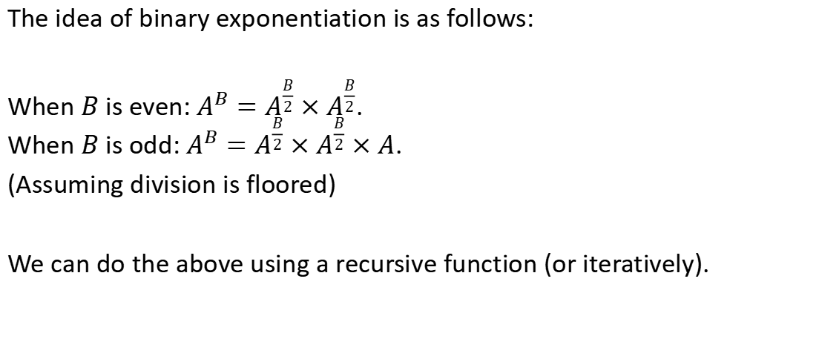
Binary Exponentiation
The idea of binary exponentiation is as follows:
When $B$ is even: $A^{B}=A^{\frac{B}{2}}×A^{\frac{B}{2}}$. When $B$ is odd: $A^{B}=A^{\frac{B}{2}}×A^{\frac{B}{2}}×A$.
(Assuming division is floored)
We can do the above using a recursive function (or iteratively).

Slide 15
Problems
https://codeforces.com/problemset/problem/472/A
https://codeforces.com/problemset/problem/1475/A
https://codeforces.com/problemset/problem/1679/A
https://codeforces.com/problemset/problem/1165/D

Slide 16
Resources
https://en.wikipedia.org/wiki/Primality_test
https://en.wikipedia.org/wiki/Sieve_of_Eratosthenes
https://cp-algorithms.com/algebra/factorization.html (advanced)
https://bit.ly/3cl0Vdj (modular arithmetic basics)

Slide 17
Thanks for watching!
Feedback form:
https://docs.google.com/forms/d/1HZJI0t88KIEhst8Ld-cLLtLOUiFcHoyc2sawD_RkC8o/edit

